Slide 1

Efficient Multiplierless FIR Filter Design: Minimizing Adder Count for Optimized Filtering
MENTOR: MRS.DHANASREE JILLELLA
DEPARTMENT OF ELECTRONICS AND COMMUNICATION
BATCH-18

Slide 2
Abstract
Designing a multiplierless FIR filter optimized with Multiple Constant Multiplication (MCM) technique.
Adders and shift-add architecture used to enable multiplication-free operations in the filter design.
Comparative assessment of various adder types (e.g., ripple-carry, carry-propagate, sum-propagate) for optimal filter design considering speed, area utilization, and power efficiency.
Exploration of different adder configurations to minimize resource consumption and meet filter parameters.
Objective to create a high-performance FIR filter with reduced computational complexity suitable for applications with limited hardware resources and power constraints.

Slide 3
Previous work
In the context of FIR (Finite Impulse Response) filters, single constant multiplication , Multiple constant multiplication refers to the optimisation of the multiplication operation involving a single constant.
By implementing with fir filter with mcm, multipliers are reduced therefore latency and power are reduced.

Slide 4
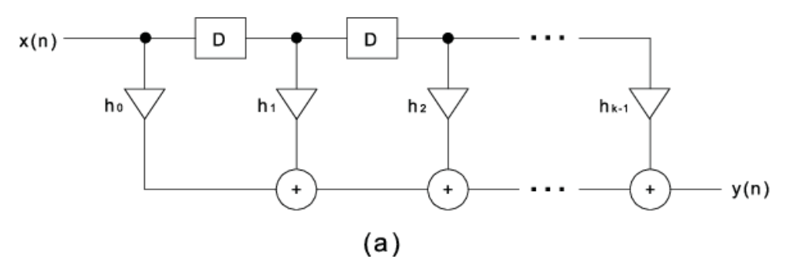
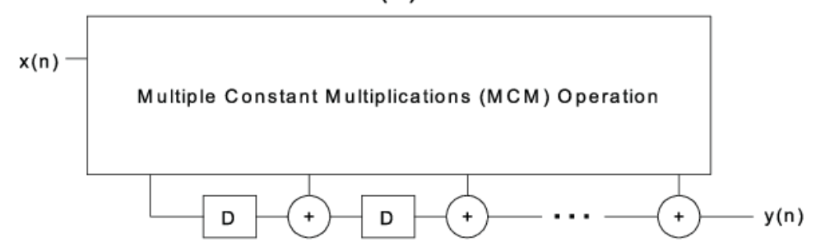
FIR FILTERS
FIR filters are one of two primary types of digital filters used in Digital Signal Processing (DSP) applications, the other type being IIR.
FIR filter is a filter whose impulse response(or response to any finite length input) is of finite duration, because it settles to zero in finite time.
The impulse response of an Nth-order discrete-time FIR filter lasts exactly N + 1 samples before it then settles to zero.
(a)
(b)
Fig: FIR Implementation

Slide 5
Proposed Method
Constant multiplication in FIR filters optimizes efficiency by minimizing multipliers and utilizing hardware for streamlined computations.
Analysing different types of adder and comparing their parameters.
The adder block in the filter is replaced by comparative analysis with different adders.
Then, the effective adder is accumulated with the fir filter, obtained optimised results.

Slide 6
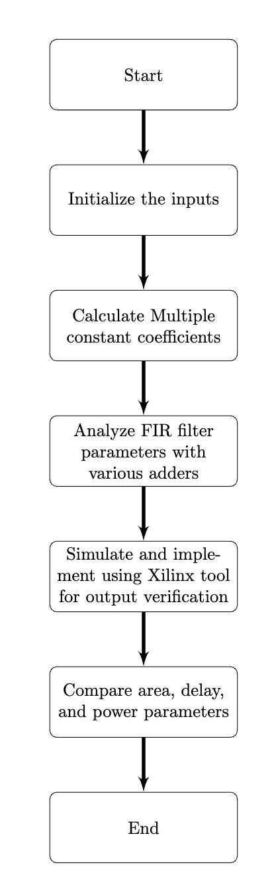
Methodology
Coefficient Decomposition (MCM)
Adder Block Selection
Comparison Metrics
Implementation and Simulation
Performance Analysis

Slide 7
MCM Method
Step 1: Identify Common Factors
Step 2: Combination of Shifts and Adds
Step 3: Lookup Tables
Step 4: Combine Partial Products
Step 5: Pipeline and Parallel Processing

Slide 8
Applications of MCM Method
MCM is involved to produce constant multiplication in Digital Signal Processing (DSP) systems.
In Error-correcting codes, involve mathematical operations with constant coefficients. MCM can be used to optimize these operations in the encoding and decoding processes.
Instruction Pipelining, by breaking down a single multiplication operation into multiple smaller ones, fill more stages of the pipeline with useful work, thereby improving overall throughput.
In such applications full fledge of multipliers are not needed.

Slide 9

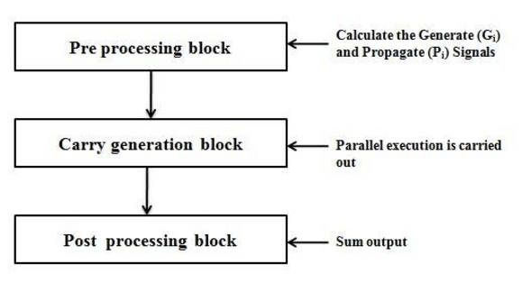
Parallel Prefix Adders
Initially compute small group of intermediate prefixes and then find large group prefixes, until all the carry bits are computed.
These adders have tree structures within a carry-computing stage similar to the carry propagate adder. However, the other two stages for these adders are called pre-computation and post-computation stages.
In pre-computation stage, each bit computes its carry generate/propagate and a temporary sum.
Post-computation in parallel prefix adders involves processing prefix sums and carries to obtain final sum and carry outputs, which are then combined to produce the complete result of the addition operation.

Slide 10
Terminology background:
Prefix: The outcome of the operation depends on the initial inputs.
Parallel: Involves the execution of an operation in parallel. This is done by segmentation into smaller pieces that are computed in parallel.
Operation: Any arbitrary primitive operator “ ° ” that is associative is parallelizable
It is fast because the processing is accomplished in a parallel fashion.

Slide 11
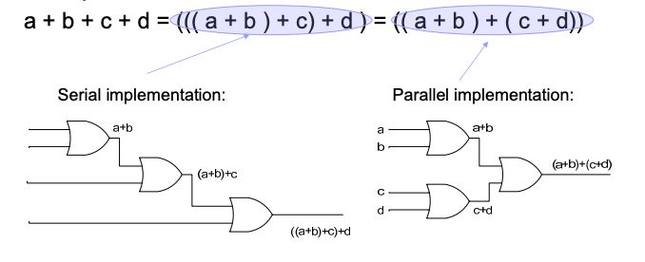

Slide 12
Carry Propagate Adders:
Carry Calculation: Carry propagate adders compute both sum and carry bits during addition.
Carry Generation: Utilize carry lookahead logic to generate carry bits efficiently.
Propagation of Carry: Incorporates carry bits into the addition process, ensuring accurate results.
Critical for Fast Arithmetic: Crucial for high-speed arithmetic operations where carry propagation delay is a significant factor.
Widely Used: Found in various digital systems requiring fast and accurate arithmetic, including microprocessors, DSPs, and ASICs.

Slide 13
Sum Propagate Adders:
Sum Calculation: Sum propagate adders directly compute the sum bits of the addition operation.
No Carry Generation: They do not generate carry bits during the addition process.
Propagation of Sum: Propagates the sum directly without considering carry bits.
Fast for Some Operations: Efficient for addition operations where carry propagation delay is not critical.
Used in Some Specialized Cases: Suitable for applications where carry bits are not needed, such as in certain data compression algorithms

Slide 14
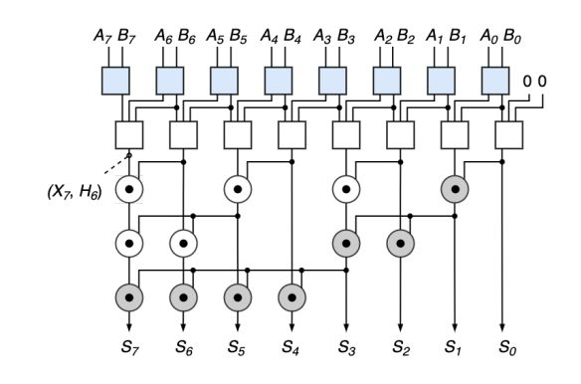
Ladner-Fisher adder
Binary Reduction: Breaks down addition into a series of binary reduction trees.
Parallel Processing: Simultaneously processes multiple bits at each stage of the binary trees.
Sum-Propagate Adder: Calculates sum bits efficiently within each reduction tree.
Hierarchical Structure: Features multiple levels of trees for processing different bit ranges.
Final Sum Calculation: Combines results from all trees to produce the final sum with reduced propagation delay
Fig: Ladner-fischer carry tree structure.

Slide 15
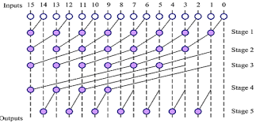
Han-Carlson adder
Parallel Input Processing: Handles multiple pairs of input bits concurrently.
Block-Based Addition: Divides inputs into smaller blocks for independent processing.
Carry Generation: Generates carry bits within each block using lookahead logic.
Parallel Carry Propagation: Propagates carry information across blocks simultaneously.
Final Sum Calculation: Combines partial sums from blocks to produce the final result.
Fig: Han-Carlson carry tree structure.

Slide 16
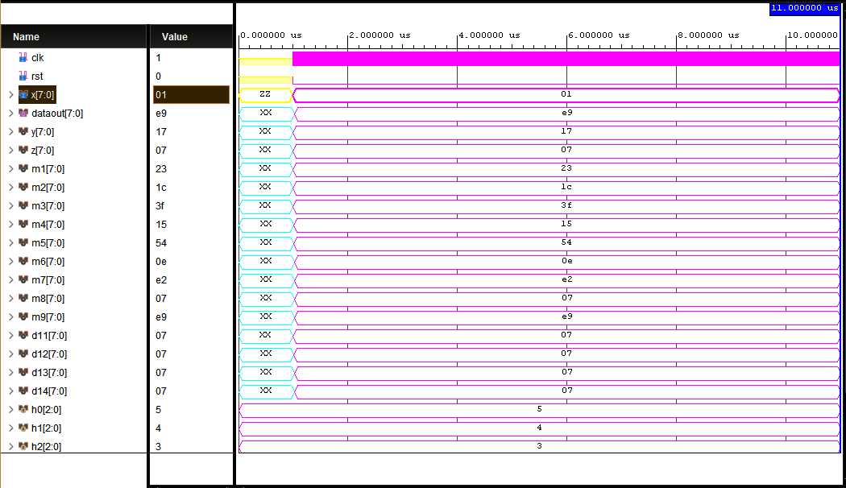
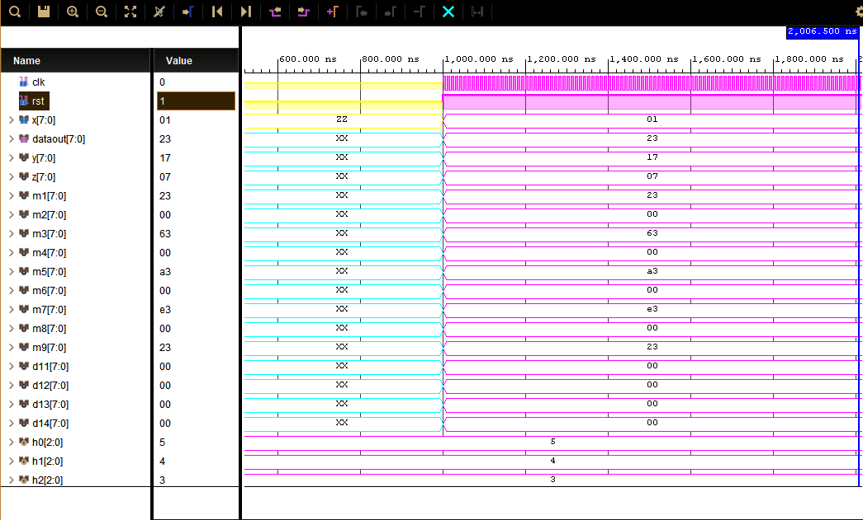
Simulations and Results
Fig: Waveform of Ladner-fischer adder(rst0).
Fig: Waveform of Ladner-fischer adder(rst1).

Slide 17
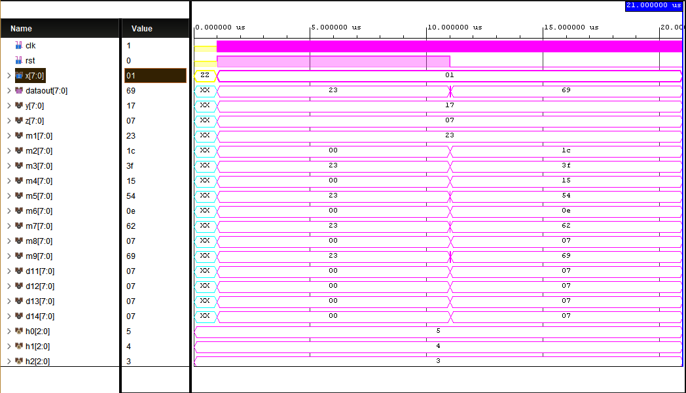
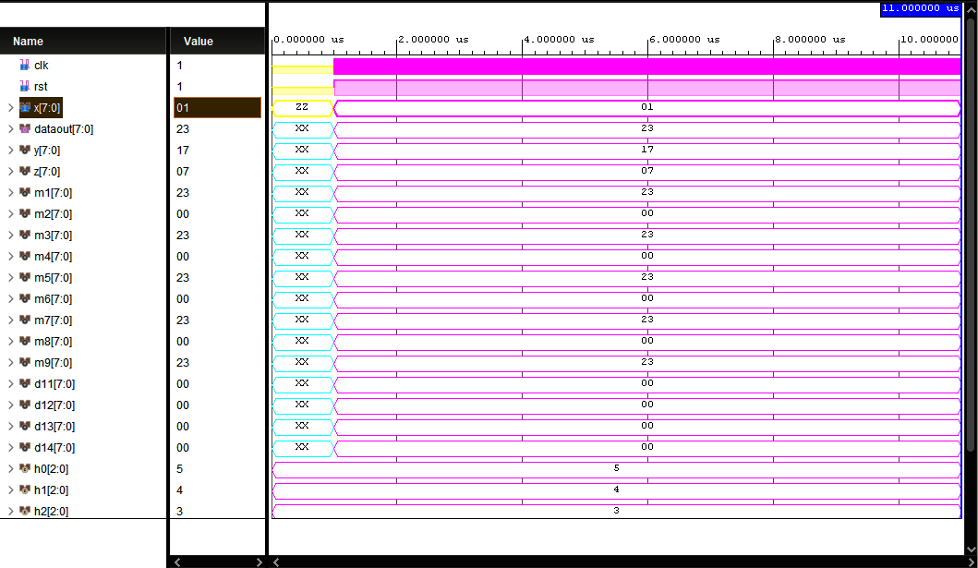
Fig: Waveform of Han-Carlson adder(rst0)
Fig: Waveform of Han-Carlson adder(rst1)

Slide 18
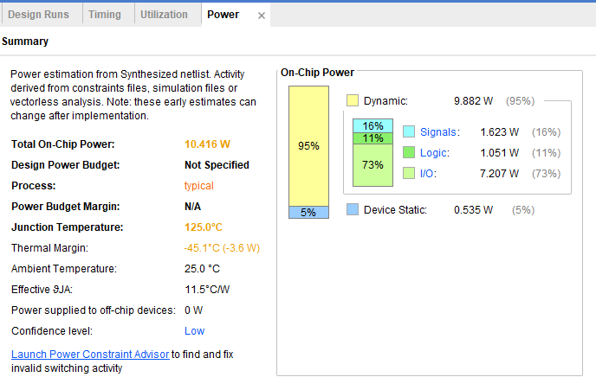
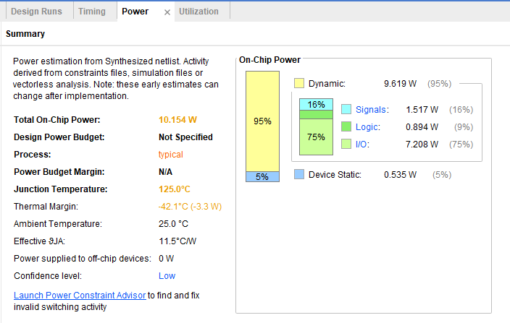
Power Report
Fig: Power report of Ladner-fischer adder.
Fig: Power report of Han-Carlson adder.

Slide 19
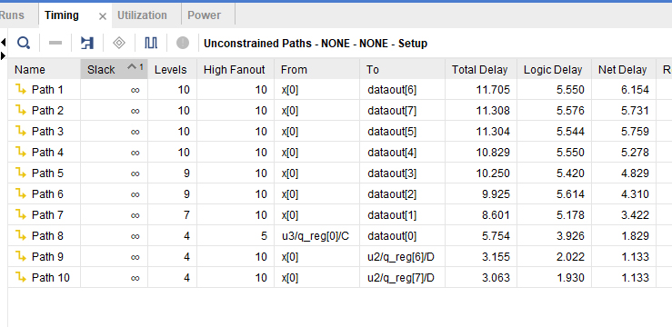
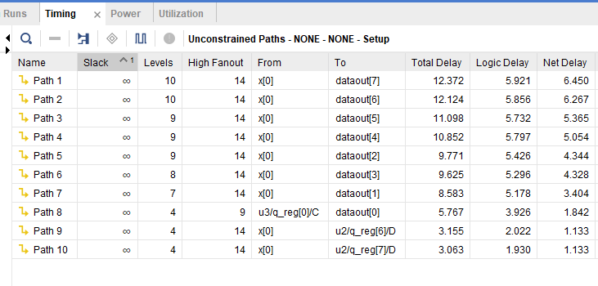
Time Delay
Fig: Delay of Ladner-fischer adder.
Fig: Delay of Han-Carlson adder.

Slide 20
Comparative Analysis
Table ; Comparative analysis of adders
Parameter | Ladner-Fisher adder | Han-Carlson adder
Power Utilization | 5.61w | 5.605w
LUT’s IOB’s | 7 16 | 8 26
Setup delay Hold delay | 5.91 ns 2.06 ns | 7.11 ns 2.06 ns

Slide 21
Comparative Analysis
Table : Comparative analysis of FIR -Filters
Parameter | Ladner-Fisher adder | Han-Carlson adder | Carry-look ahead adder
Power | 10.416w | 10.514w | 10.324w
LUT’s IOB’s | 54 18 | 57 18 | 61 18
Delay | 11.705ns | 12.372 ns | 12.755ns

Slide 22
Future Scope
Design and Implementation: FIR filters are initially designed and implemented using digital signal processing techniques tailored to specific requirements like bandwidth, frequency response, and noise rejection.
Integration with Hardware Platforms: These filters are then seamlessly integrated into customized hardware platforms alongside MCM modules, creating a unified system for signal conditioning and multiplication tasks.
Preprocessing Input Data Streams: FIR filters preprocess input data streams before multiplication operations, improving signal quality by filtering noise, shaping signals, and eliminating unwanted frequency components.

Slide 23
Conclusion
- Leveraging efficient adders like Ladner-Fischer alongside MCM techniques enhances digital circuit performance, especially in FIR filters.
- Ladner-Fischer Adder demonstrates superior timing performance compared to traditional adders like PPA and RCA, despite slightly higher LUT utilization.
- Optimization of circuit architecture is crucial to striking a balance between resource utilization and timing efficiency, emphasizing the importance of adder selection in digital circuit design.

Slide 24
APPLICATIONS
Targeting specific hardware platforms
Pipelining
LANGUAGES AND TOOLS
Verilog HDL
Vivado

Slide 25
TEAM:
KAMBALA CHANDU - 620147
NAMALA SAI SREEKAR - 620217
PRODDUTURI SIRI - 620228
THANK YOU

